Slide 1
Bioinformatics
Faster, better, stronger

Slide 2
De stof komt uit de college presentaties en Jonathan Pevsner "Bioinformatics and Functional Genomics"
(Wiley Blackwell; 3e editie) en een aantal extra papers
(deze worden niet expliciet in de betrokken colleges genoemd, en zijn te vinden onder "achtergrond").
Lecture | Topic | Chapter | Pages | Comments
1 | Bioinformatics | 1 | Helemaal
2 | Access to seq data | 2 | Helemaal | Niet "Command line access"
3 | Sequence Alignment | 3 | 70-103 | Niet box 3.5, box 3.7, box 3.8
4 | BLAST | 4 | 121-134, 138-143, 145-159 | Niet fig.4.14, box 4.1, p.143 E- en p-values
5 | Database searching | 5 | 171-177 | Niet box 5.1
6 | Next Generation Sequencing | 9 | 377-384

Slide 3
Presentation content
Chapter 2

Slide 4
Chapter 2:
Access to Information
Jonathan Pevsner, Ph.D.
pevsner@kennedykrieger.org
Bioinformatics and Functional Genomics
(Wiley-Liss, 3rd edition, 2015)
You may use this PowerPoint for teaching purposes

Slide 5
Biological databases: two perspectives
We might want to study one gene, protein, DNA molecule, or other type of object in a database. For example, for human beta globin there is a gene (HBB), a protein sequence, a protein structure, and entries for various kinds of variation.
We can think about large groups, such as all the globin genes in the human genome, or all the known HBB variants. Or we might want to study a set of 100 genes previously implicated in a disease (e.g. autism) to assess their variation in patient samples.
These are different ways of thinking about searching databases.
B&FG 3e
Page 20

Slide 6
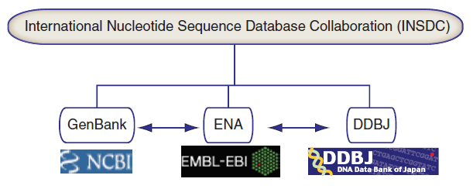
INSDC coordinates sequence data
B&FG 3e
Fig. 2-1
Page 20

Slide 7
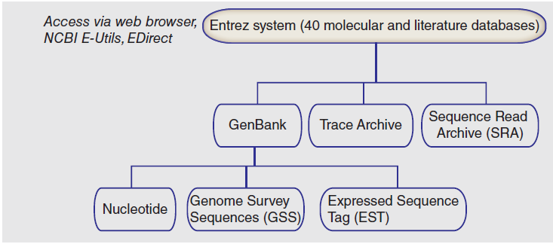
National Center for Biotechnology Information (NCBI): organization
B&FG 3e
Fig. 2-2
Page 21

Slide 8
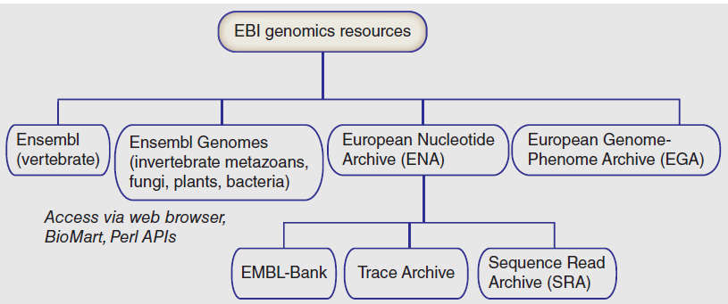
European Bioinformatics Institute (EBI): organization
B&FG 3e
Fig. 2-2
Page 21

Slide 9
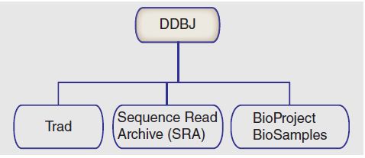
DNA Database of Japan (DDBJ): organization
B&FG 3e
Fig. 2-2
Page 21

Slide 10
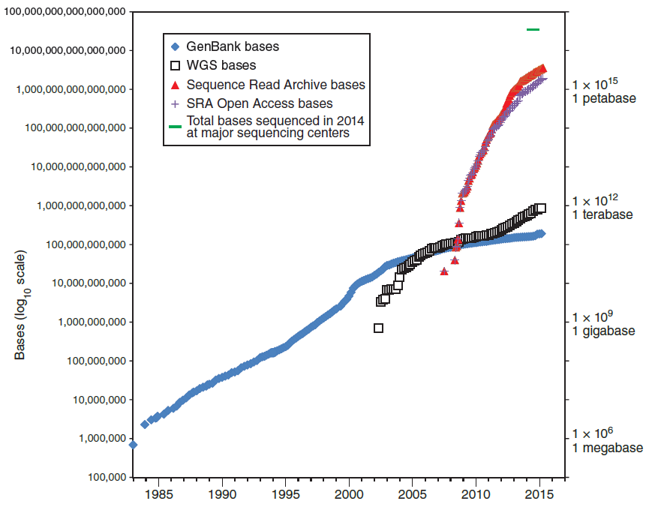
Growth of DNA sequence in repositories
B&FG 3e
Fig. 2-3
Page 22
Year

Slide 11
Growth of DNA sequence in repositories
A vast amount of sequence data has been generated using next-generation sequence technology! (Most are open access, some have human subjects data.)
B&FG 3e
Fig. 2-3
Page 22
Year

Slide 12
Growth of DNA sequence in repositories
Perhaps 40 petabases of DNA were generated in calendar year 2014 at major sequencing centers (see Chapter 15).
B&FG 3e
Fig. 2-3
Page 22
Year

Slide 13
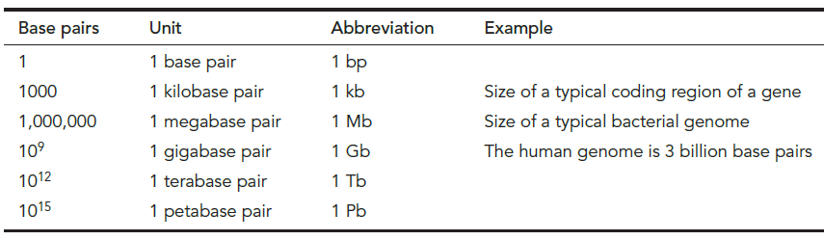
Scales of DNA base pairs
B&FG 3e
Table 2.1
Page 23

Slide 14
Scales of file sizes
Size | Abbrev- iation | # bytes | Example
Bytes | -- | 1 | Single text character
Kilobytes | 1 kb | 10³ | Text file, 1000 characters
Megabytes | 1 MB | 10⁶ | Text file, 1m characters
Gigabytes | 1 GB | 10⁹ | Size of GenBank: 600 GB
Terabytes | 1 TB | 10¹² | Size of 1000 Genomes Project: <500 TB
Petabytes | 1 PB | 10¹⁵ | Size of SRA at NCBI: 5 PB
Exabytes | 1 EB | 10¹⁸ | Annual worldwide output: >2 EB
B&FG 3e
Table 2.2
Page 23

Slide 15
Contents of databases
We can look at the number of taxa (e.g. species) in GenBank; the most sequenced organisms; types of data; and look at a particular example, the UniGene database of expressed sequence tags (ESTs).
B&FG 3e
Page 24

Slide 16
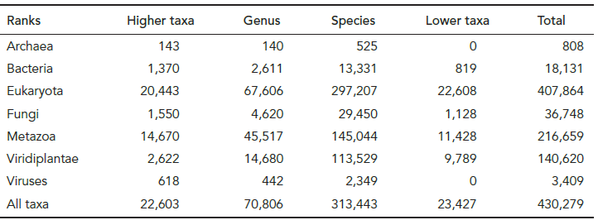
Taxa represented in GenBank (at NCBI)
B&FG 3e
Tab. 2-3
Page 24
http://www.ncbi.nlm.nih.gov/Taxonomy/txstat.cgi

Slide 17
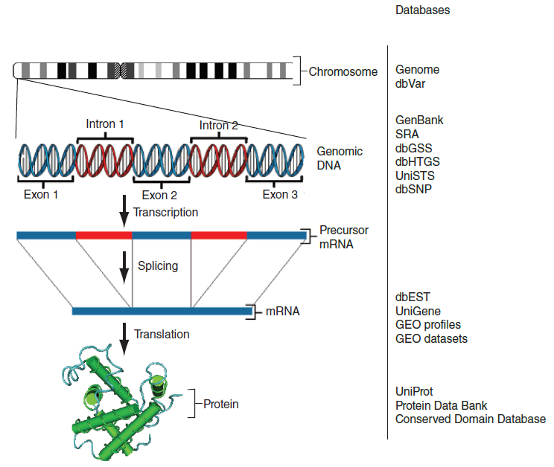
Types of data and examples of databases
B&FG 3e
Fig. 2-4
Page 26

Slide 18
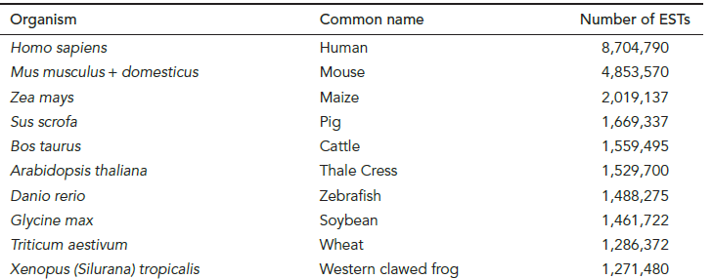
Top ten organisms for which expressed sequence tags (ESTs) have been sequenced
B&FG 3e
Tab. 2-5
Page 28
http://www.ncbi.nlm.nih.gov/dbEST/dbEST_summary.html

Slide 19
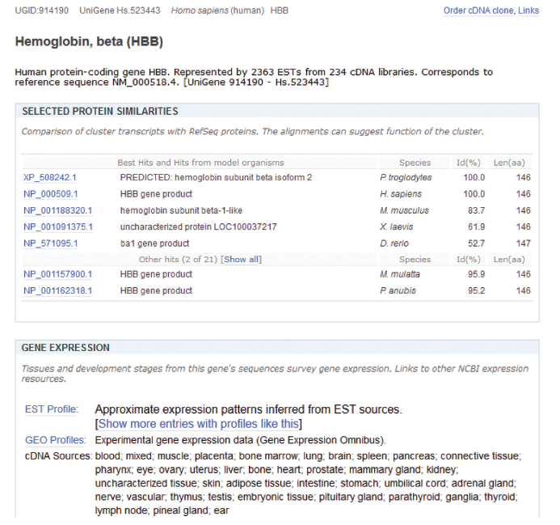
UniGene database: clusters of EST sequences
B&FG 3e
Fig. 2-5
Page 30

Slide 20
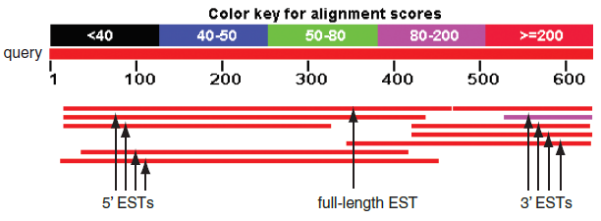
UniGene database: clusters of EST sequences
B&FG 3e
Fig. 2-5
Page 30

Slide 21
Central bioinformatics resource: NCBI
NCBI (with Ensembl, EBI, UCSC) is one of the central bioinformatics sites. It includes:
PubMed
Entrez search engine integrating ~40 databases
BLAST (Basic Local Alignment Search Tool, Chapters 3-5)
Online Mendelian Inheritance in Man (OMIM, Chapter 21)
Taxonomy
Books
many additional resources
B&FG 3e
Page 31

Slide 22
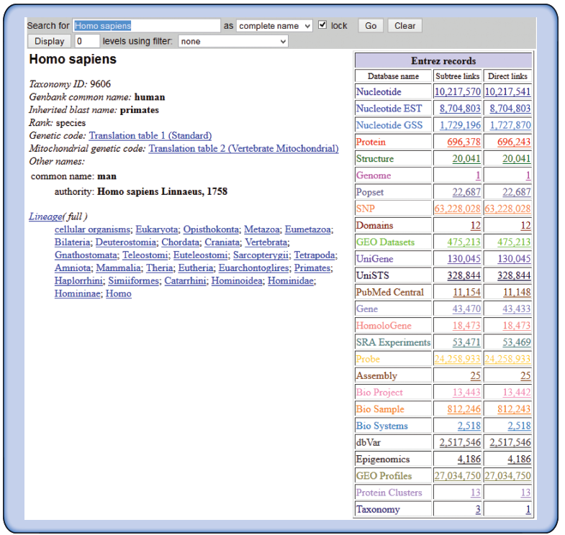
Access to NCBI databases via Taxonomy Browser
Taxonomy offers lineage information, data on rank and genetic code, and convenient Entrez database links
B&FG 3e
Fig. 2-6
Page 33

Slide 23
Accession numbers are labels for sequences
NCBI includes databases (such as GenBank) that contain information on DNA, RNA, or protein sequences.
You may want to acquire information beginning with a
query such as the name of a protein of interest, or the
raw nucleotides comprising a DNA sequence of interest.
DNA sequences and other molecular data are tagged with accession numbers that are used to identify a sequence
or other record relevant to molecular data.
B&FG 3e
Page 34
Page 26

Slide 24
What is an accession number?
An accession number is a label used to identify a sequence. It is a string of letters and/or numbers that corresponds to a molecular sequence.
Examples:
CH471100.2 GenBank genomic DNA sequence
NC_000001.10 Genomic contig
rs121434231 dbSNP (single nucleotide polymorphism)
AI687828.1 An expressed sequence tag (1 of 184)
NM_001206696 RefSeq DNA sequence (from a transcript)
NP_006138.1 RefSeq protein
CAA18545.1 GenBank protein
O14896 SwissProt protein
1KT7 Protein Data Bank structure record
DNA
RNA
protein
B&FG 3e
Page 34

Slide 25
NCBI’s important RefSeq project:
best representative sequences
RefSeq (accessible via the main page of NCBI)
provides an expertly curated accession number that
corresponds to the most stable, agreed-upon “reference”
version of a sequence.
RefSeq identifiers include the following formats:
Complete genome NC_######
Complete chromosome NC_######
Genomic contig NT_######
mRNA (DNA format) NM_###### e.g. NM_006744
Protein NP_###### e.g. NP_006735
B&FG 3e
Page 34

Slide 26
Access to sequences: Gene resource at NCBI
NCBI Gene is a great starting point: it collects
key information on each gene/protein from
major databases. It covers all major organisms.
RefSeq provides a curated, optimal accession number for each DNA (NM_000518 for beta globin DNA corresponding to mRNA) or protein (NP_000509)
B&FG 3e
Page 38

Slide 27
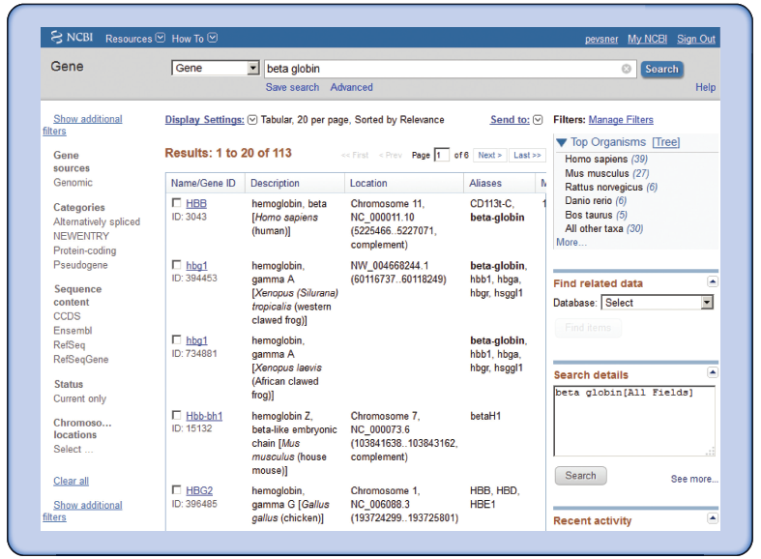
NCBI Gene: example of query for beta globin
B&FG 3e
Fig. 2.8
Page 38

Slide 28
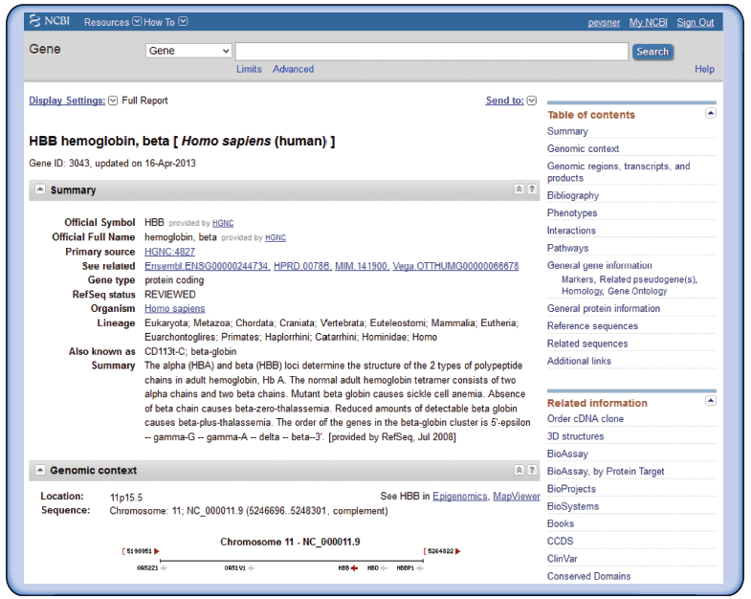
NCBI Gene: example of query for beta globin
B&FG 3e
Fig. 2.9
Page 39

Slide 29
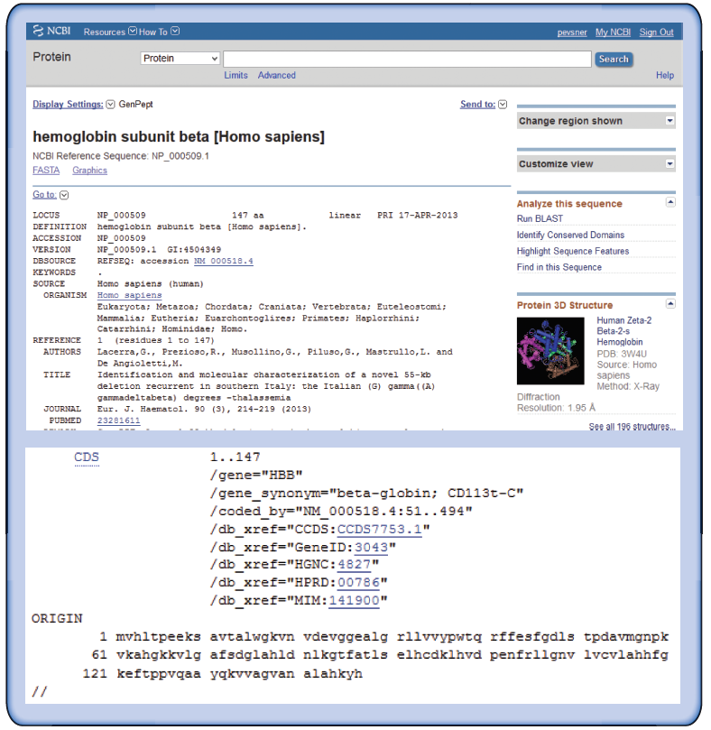
NCBI Protein: hemoglobin subunit beta
B&FG 3e
Fig. 2.10
Page 40

Slide 30
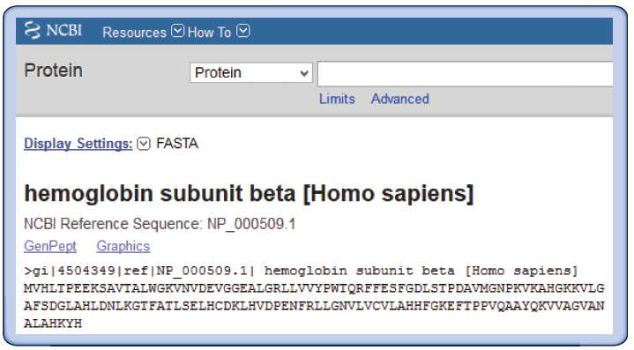
NCBI Protein: hemoglobin subunit beta
in the FASTA format
B&FG 3e
Fig. 2.11
Page 41

Slide 31
Access to sequences: Gene resource at NCBI
NCBI Gene is a great starting point: it collects
key information on each gene/protein from
major databases. It covers all major organisms.
RefSeq provides a curated, optimal accession number for each DNA (NM_000518 for beta globin DNA corresponding to mRNA) or protein (NP_000509)
B&FG 3e
Page 38

